Slide 1


AMD AI Hackathon
India
Team-BYOK
Track-2- Develop an AI Scheduling Assistant on AMD Instinct MI300

Slide 2
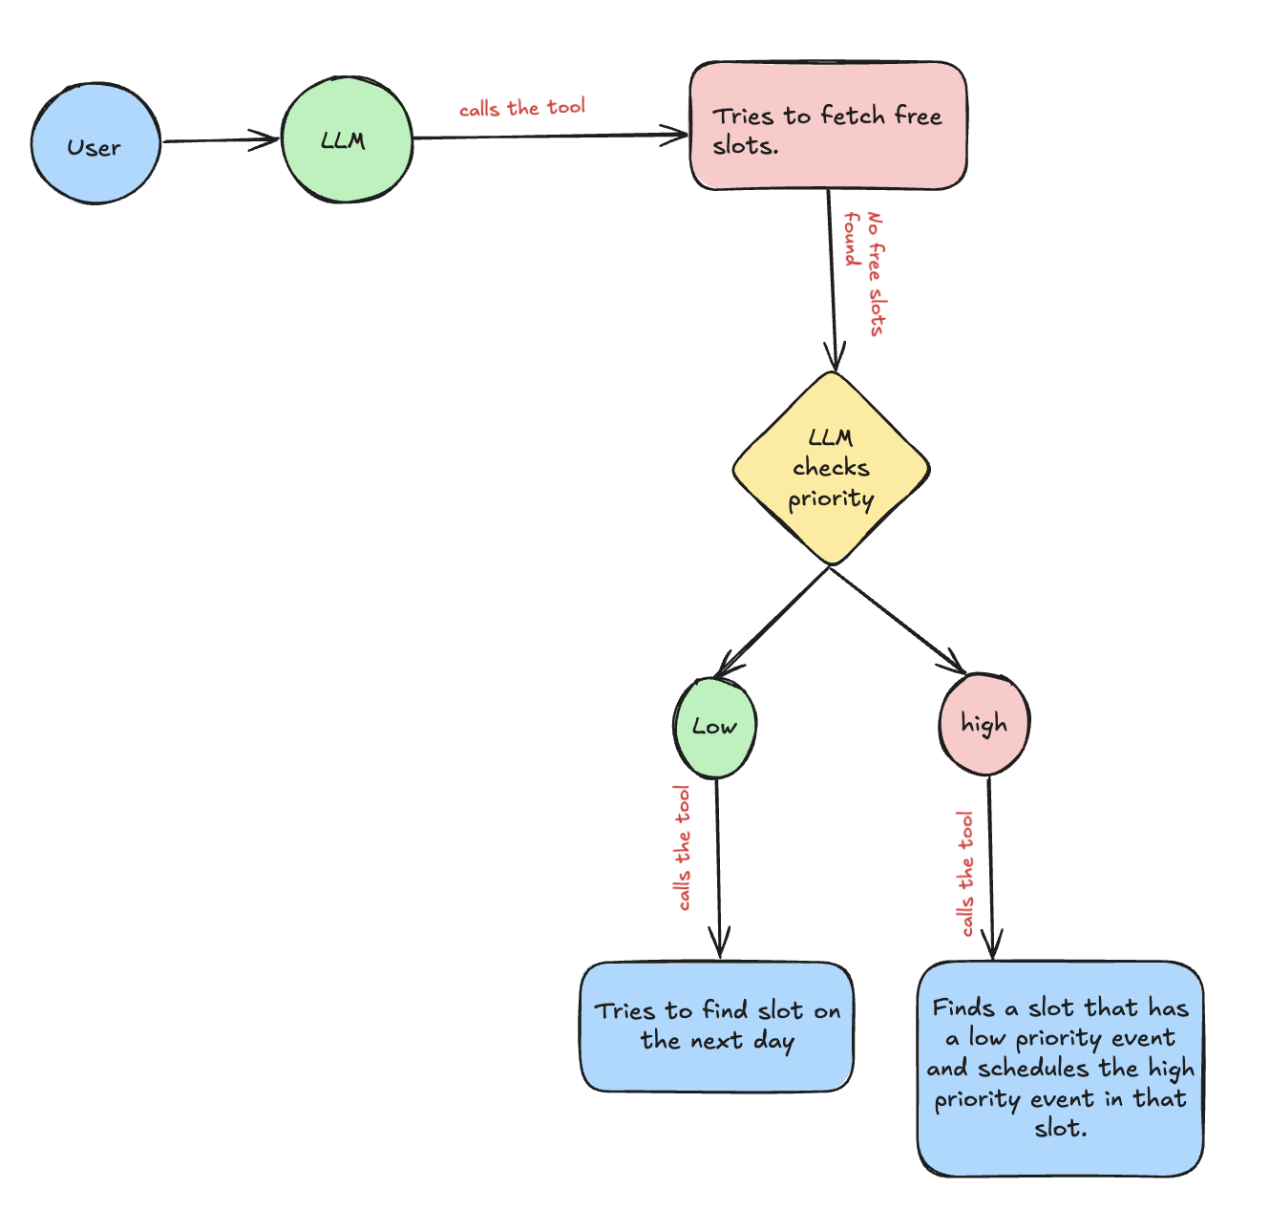
Architecture

Slide 3
Flow Explanation
User Request:
User initiates a request to schedule a meeting.
LLM Invocation:
Receives the user's request and calls a tool to check for available time slots in the calendar by parsing the start and end date provided by the user in the promt.
Free Slot Check:
If free slots are available, the meeting is scheduled.
If no free slots are found, LLaMA:
Uses the meeting description to determine its priority using prompt-based classification.
Priority Handling Logic:
Low Priority:
Calls the tool to search for a slot on the next day.
High Priority:
Compares the high-priority request with existing events.
Identifies a low-priority scheduled event, and reschedules it to accommodate the urgent one.

Slide 4
Key Features:
Natural Language Understanding Parses user requests using LLaMA prompts to extract intent, date, time, and meeting context.
Priority Classification via Prompts Uses prompt-based classification to determine meeting urgency (e.g., "urgent", "RCA", "client").
Smart Rescheduling If no free slot is found, LLaMA evaluates existing events and reschedules lower priority ones to accommodate high-priority meetings.
Fallback Scheduling For low-priority meetings, the system automatically searches for availability on the next day.
Tool Invocation Dynamically invokes backend tools (e.g., Google Calendar APIs) for slot fetching, rescheduling, and conflict resolution.
Context-Aware Comparison Evaluates priority vs. existing events to make intelligent rescheduling decisions.
Time Window Parsing Parses and understands the time window from the user input to query only relevant slots.
Scalable Design Easily extendable to support multi-user scheduling or recurring events.

Slide 5
Thank You !!

